Slide 1
Frequentist vs. Bayes
Sophia Lu

Slide 2
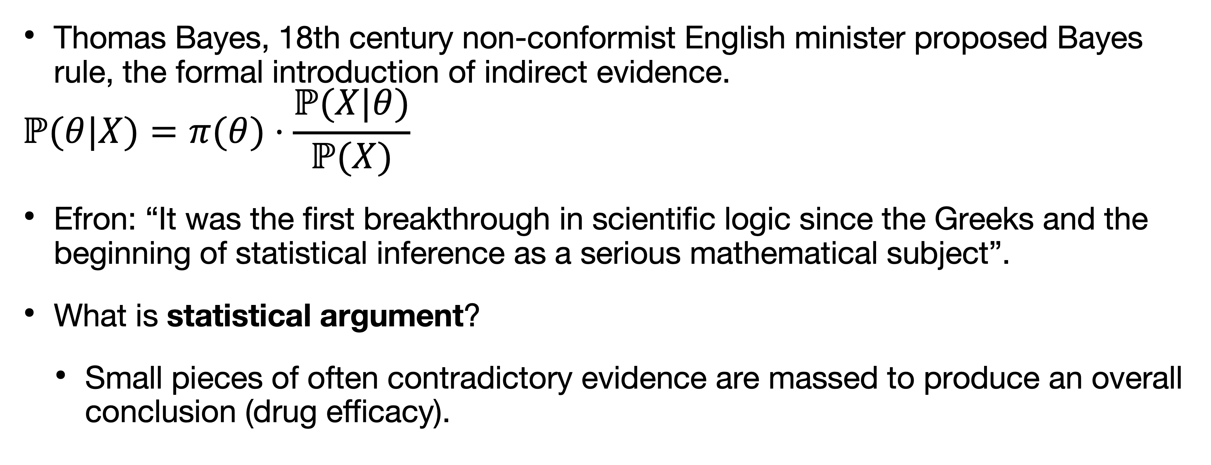
Introduction
Thomas Bayes, 18th century non-conformist English minister proposed Bayes rule, the formal introduction of indirect evidence.
$$ℙ(θ|X)=π(θ)⋅\frac{ℙ(X|θ)}{ℙ(X)}$$
Efron: “It was the first breakthrough in scientific logic since the Greeks and the beginning of statistical inference as a serious mathematical subject”.
What is statistical argument?
Small pieces of often contradictory evidence are massed to produce an overall conclusion (drug efficacy).

Slide 3
Introduction
What is statistical argument?
Small pieces of often contradictory evidence are massed to produce an overall conclusion (drug efficacy).
What is Bayesian statistics?
Learning from experience: direct and indirect.

Slide 4
Example
Consider drug efficacy (direct evidence): a clinical trial has three arms: placebo, single dose, double dose.
Suppose the single dose/placebo trial yields nearly significant result (p-value = 0.07). Should we approve?
Now suppose double dose/placebo yields strongly significant results in favor of new drug (p-value = 0.000001). Should we approve?

Slide 5
Example
Even if double dose/placebo yields strongly significant results in favor of new drug, if the result for the single dose/placebo trial yields a nonsignificant result (p-value = 0.07), drug will not earn approval.
Single dose is very likely to be vindicated in subsequent testing because double dose adds strong indirect evidence to the direct, nearly significant, single dose outcome.

Slide 6
Direct vs. indirect evidence
Learning only from direct experience is the dominant feature of contemporary applied statistics; but why not make use of indirect evidence when available?
The increasingly large and complicated data sets call for the adequate analysis and adjustment for indirect evidence.
Efron: “It is fair to say that we are living in a new era of statistical applications, one that is putting pressure on traditional Bayesian and frequentist methodologies.”
The Big Data era will force us to rethink frequentist and Bayesian practices.

Slide 7
Direct vs. indirect evidence
A fundamental Bayesian difficulty is that well-founded prior distributions are rare in scientific practice; the ideal is to use the experience of others without the need for subjective prior distributions.
L. J. Savage’s: “to enjoy the Bayesian omelette without breaking the Bayesian eggs.”

Slide 8
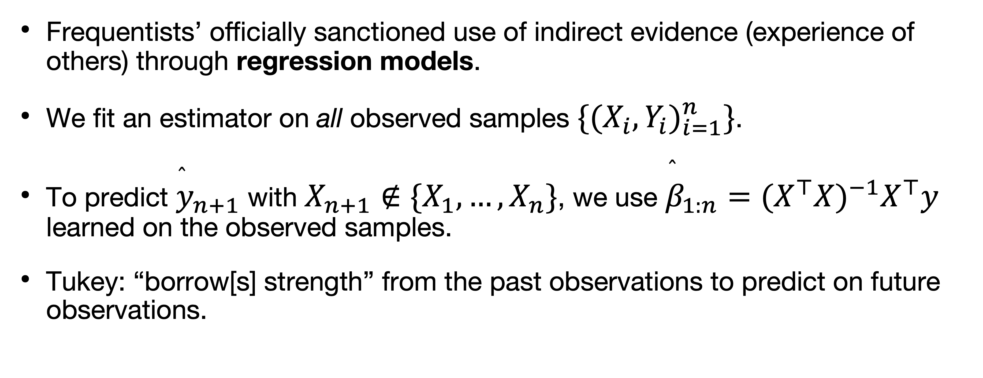
Frequentist usage of indirect evidence via regression models
Frequentists’ officially sanctioned use of indirect evidence (experience of others) through regression models.
We fit an estimator on all observed samples $\{(X_{i},Y_{i})_{i=1}^{n}\}$.
To predict ${\overset{̂}{y}}_{n+1}$ with $X_{n+1}∉\{X_{1},…,X_{n}\}$, we use ${\overset{̂}{β}}_{1:n}=(X^{⊤}X)^{−1}X^{⊤}y$ learned on the observed samples.
Tukey: “borrow[s] strength” from the past observations to predict on future observations.

Slide 9
Frequentist-Bayesian bridge
James-Stein
Benjamini-Hochberg

Slide 10
Frequentist-Bayesian bridge
James-Stein
Benjamini-Hochberg

Slide 11
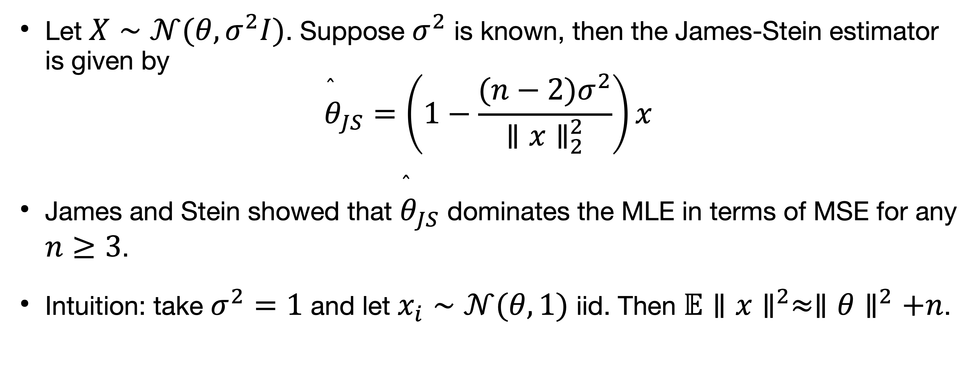
James-Stein estimation
Let $X∼𝒩(θ,σ^{2}I)$. Suppose $σ^{2}$ is known, then the James-Stein estimator is given by
$${\overset{̂}{θ}}_{JS}=\left(1−\frac{(n−2)σ^{2}}{∥x∥_{2}^{2}}\right)x$$
James and Stein showed that ${\overset{̂}{θ}}_{JS}$ dominates the MLE in terms of MSE for any $n≥3$.
Intuition: take $σ^{2}=1$ and let $x_{i}∼𝒩(θ,1)$ iid. Then $𝔼∥x∥^{2}≈∥θ∥^{2}+n$.

Slide 12
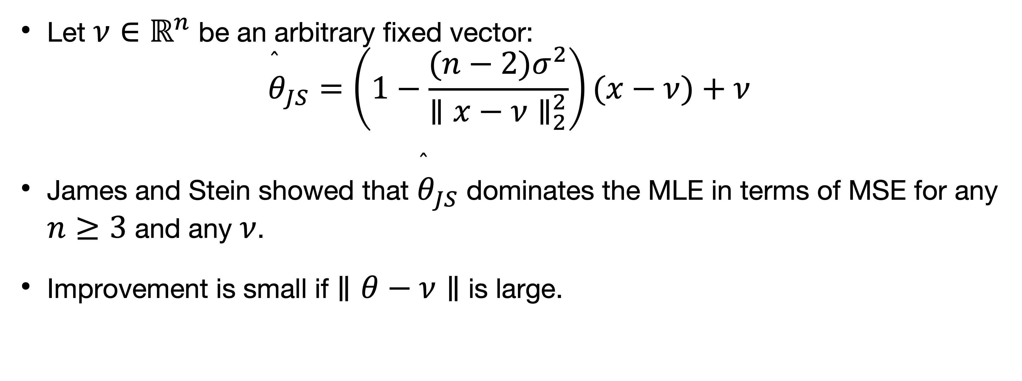
James-Stein estimation
Let $ν∈ℝ^{n}$ be an arbitrary fixed vector:
$${\overset{̂}{θ}}_{JS}=\left(1−\frac{(n−2)σ^{2}}{∥x−ν∥_{2}^{2}}\right)(x−ν)+ν$$
James and Stein showed that ${\overset{̂}{θ}}_{JS}$ dominates the MLE in terms of MSE for any $n≥3$ and any $ν$.
Improvement is small if $∥θ−ν∥$ is large.

Slide 13
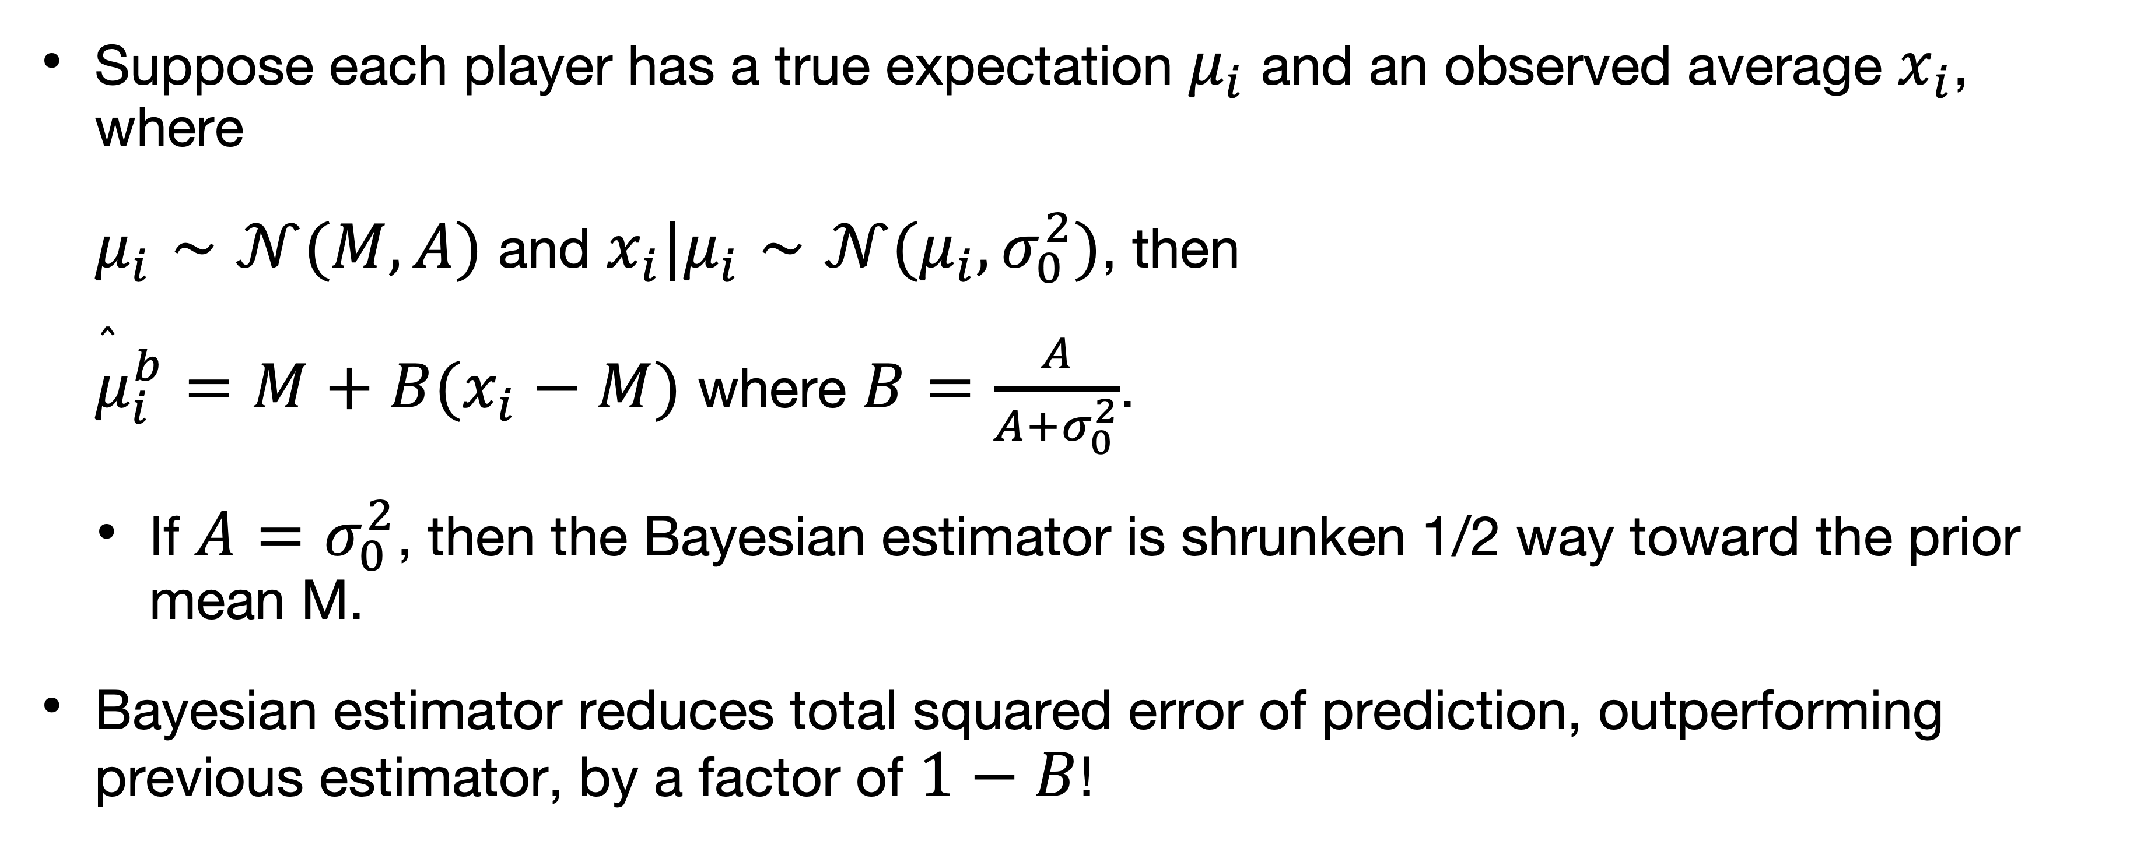
James-Stein estimation
Suppose each player has a true expectation $μ_{i}$ and an observed average $x_{i}$, where
$μ_{i}∼𝒩(M,A)$ and $x_{i}|μ_{i}∼𝒩(μ_{i},σ_{0}^{2})$, then
${\overset{̂}{μ}}_{i}^{b}=M+B(x_{i}−M)$ where $B=\frac{A}{A+σ_{0}^{2}}$.
If $A=σ_{0}^{2}$, then the Bayesian estimator is shrunken 1/2 way toward the prior mean M.
Bayesian estimator reduces total squared error of prediction, outperforming previous estimator, by a factor of $1−B$!

Slide 14
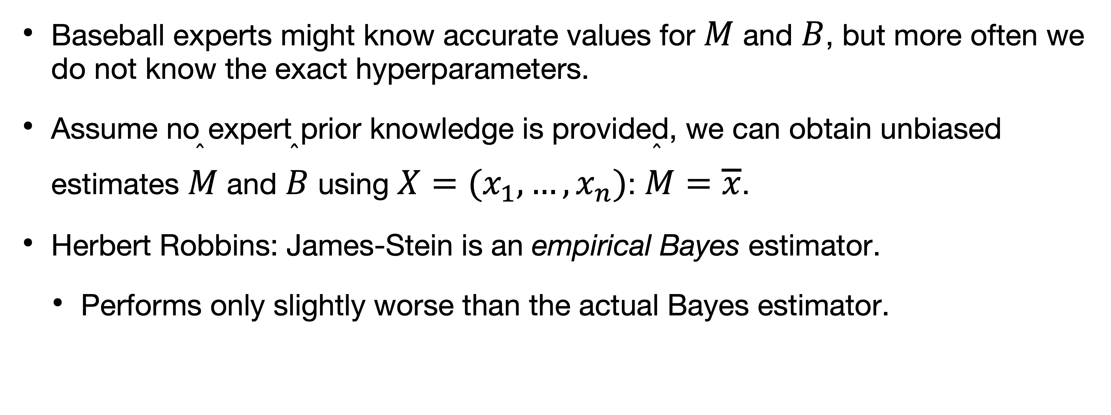
James-Stein estimation
Baseball experts might know accurate values for $M$ and $B$, but more often we do not know the exact hyperparameters.
Assume no expert prior knowledge is provided, we can obtain unbiased estimates $\overset{̂}{M}$ and $\overset{̂}{B}$ using $X=(x_{1},…,x_{n})$: $\overset{̂}{M}=\overline{x}$.
Herbert Robbins: James-Stein is an empirical Bayes estimator.
Performs only slightly worse than the actual Bayes estimator.

Slide 15
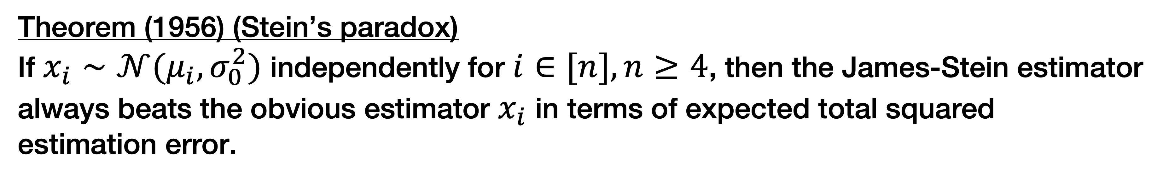
James-Stein estimation
In fact, regardless of the prior used, if any, James and Stein (1956) showed that:
Theorem (1956) (Stein’s paradox)
If $x_{i}∼𝒩(μ_{i},σ_{0}^{2})$ independently for $i∈[n],n≥4$, then the James-Stein estimator
always beats the obvious estimator $x_{i}$ in terms of expected total squared
estimation error.

Slide 16
James-Stein paradox
James-Stein is not a panacea: small MSE conceals the fact that the estimator performs poorly on outlying cases.
Clemente problem: Clemente, an unusually good hitter, is learning too much from the experience of mediocre hitters in his cohort.

Slide 17
Frequentist-Bayesian bridge
James-Stein
Benjamini-Hochberg

Slide 18
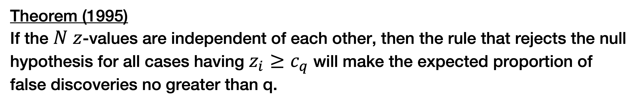
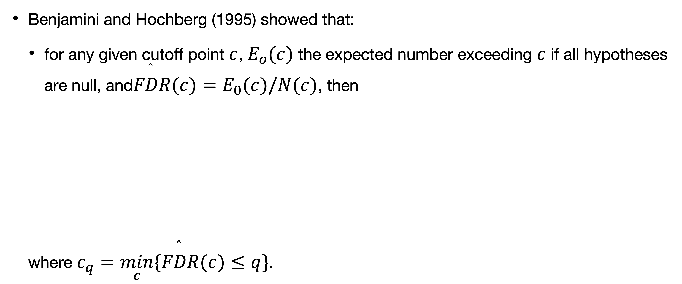
Large-scale multiple inference
Benjamini and Hochberg (1995) showed that:
for any given cutoff point $c$, $E_{o}(c)$ the expected number exceeding $c$ if all hypotheses are null, and$\overset{̂}{FDR}(c)=E_{0}(c)/N(c)$, then
where $c_{q}=\min_{c}\{\overset{̂}{FDR}(c)≤q\}$.
Theorem (1995)
If the $N$ $z$-values are independent of each other, then the rule that rejects the null
hypothesis for all cases having $z_{i}≥c_{q}$ will make the expected proportion of false discoveries no greater than q.

Slide 19
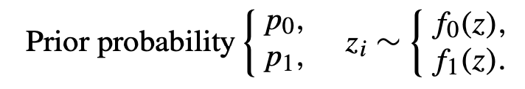
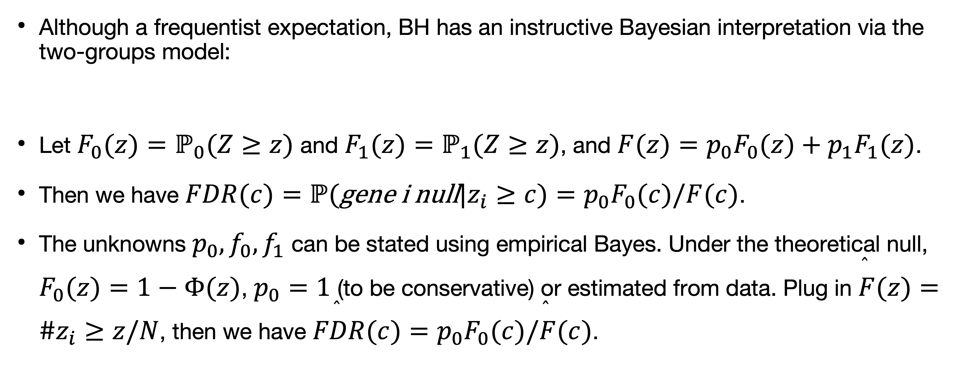
Large-scale multiple inference
Although a frequentist expectation, BH has an instructive Bayesian interpretation via the two-groups model:
Let $F_{0}(z)=ℙ_{0}(Z≥z)$ and $F_{1}(z)=ℙ_{1}(Z≥z)$, and $F(z)=p_{0}F_{0}(z)+p_{1}F_{1}(z)$.
Then we have $FDR(c)=ℙ(\text{gene} \text{i} \text{null}|z_{i}≥c)=p_{0}F_{0}(c)/F(c)$.
The unknowns $p_{0},f_{0},f_{1}$ can be stated using empirical Bayes. Under the theoretical null, $F_{0}(z)=1−Φ(z)$, $p_{0}=1$ (to be conservative) or estimated from data. Plug in $\overset{̂}{F}(z)=\#z_{i}≥z/N$, then we have $\overset{̂}{FDR}(c)=p_{0}F_{0}(c)/\overset{̂}{F}(c)$.

Slide 20
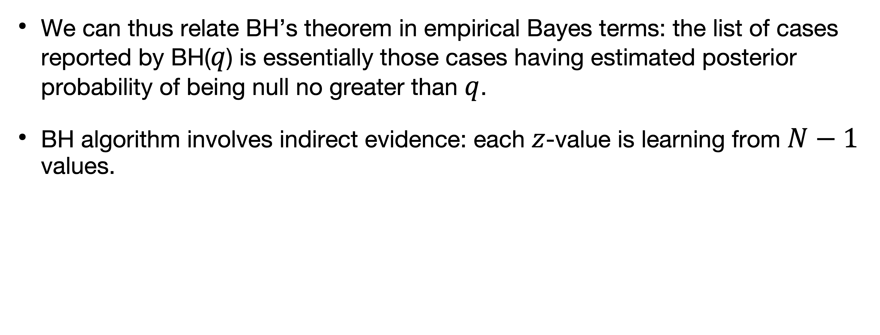
Large-scale multiple inference
We can thus relate BH’s theorem in empirical Bayes terms: the list of cases reported by BH($q$) is essentially those cases having estimated posterior probability of being null no greater than $q$.
BH algorithm involves indirect evidence: each $z$-value is learning from $N−1$ values.

Slide 21
Frequentist-Bayesian bridge
James-Stein
Benjamini-Hochberg
Normal hierarchical model

Slide 22
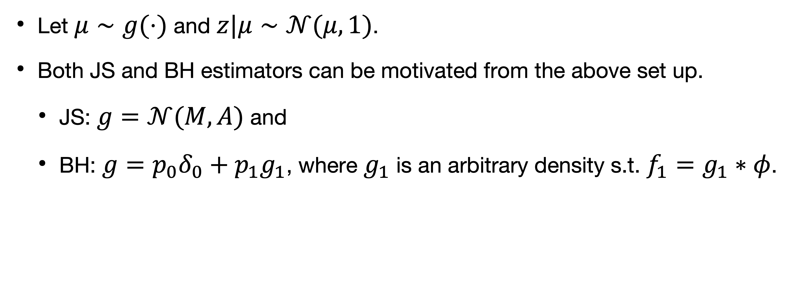
Normal hierarchical model
Let $μ∼g(⋅)$ and $z|μ∼𝒩(μ,1)$.
Both JS and BH estimators can be motivated from the above set up.
JS: $g=𝒩(M,A)$ and
BH: $g=p_{0}δ_{0}+p_{1}g_{1}$, where $g_{1}$ is an arbitrary density s.t. $f_{1}=g_{1}∗φ$.

Slide 23
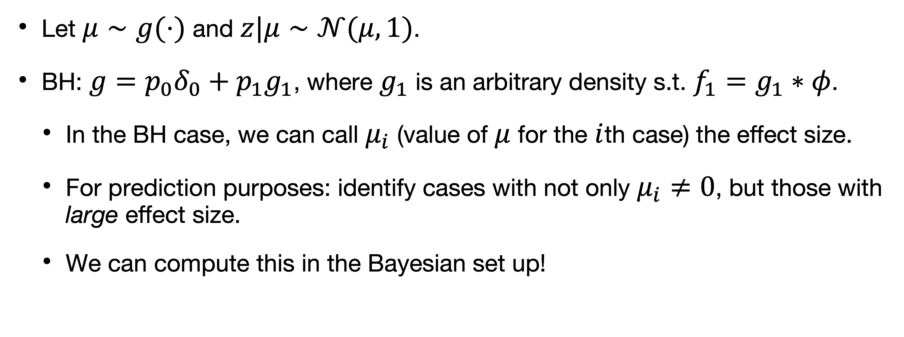
Normal hierarchical model
Let $μ∼g(⋅)$ and $z|μ∼𝒩(μ,1)$.
BH: $g=p_{0}δ_{0}+p_{1}g_{1}$, where $g_{1}$ is an arbitrary density s.t. $f_{1}=g_{1}∗φ$.
In the BH case, we can call $μ_{i}$ (value of $μ$ for the $i$th case) the effect size.
For prediction purposes: identify cases with not only $μ_{i}≠0$, but those with large effect size.
We can compute this in the Bayesian set up!

Slide 24
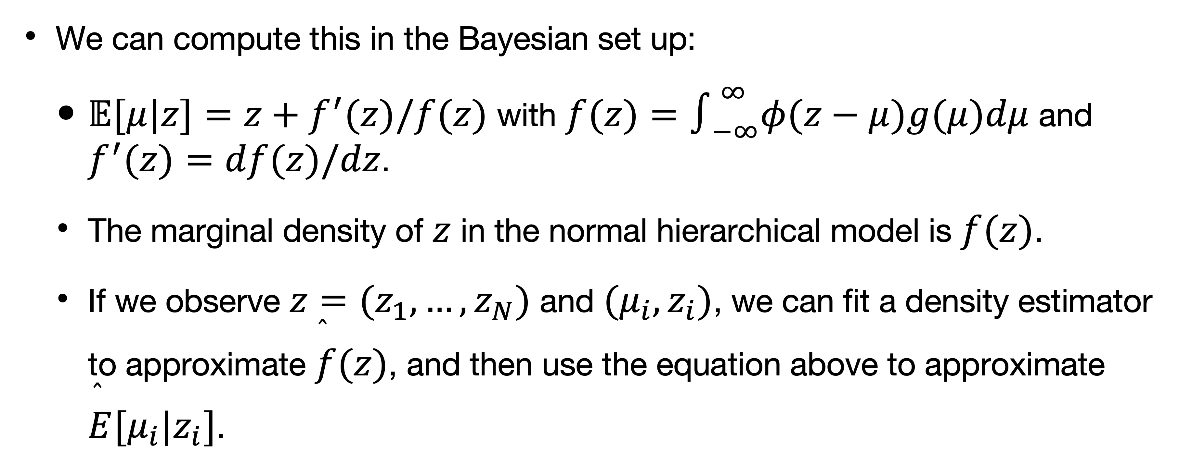
Normal hierarchical model
We can compute this in the Bayesian set up:
$𝔼[μ|z]=z+f^{′}(z)/f(z)$ with $f(z)=∫_{−∞}^{∞}φ(z−μ)g(μ)dμ$ and $f^{′}(z)=df(z)/dz$.
The marginal density of $z$ in the normal hierarchical model is $f(z)$.
If we observe $z=(z_{1},…,z_{N})$ and $(μ_{i},z_{i})$, we can fit a density estimator to approximate $\overset{̂}{f}(z)$, and then use the equation above to approximate $\overset{̂}{E}[μ_{i}|z_{i}]$.

Slide 25
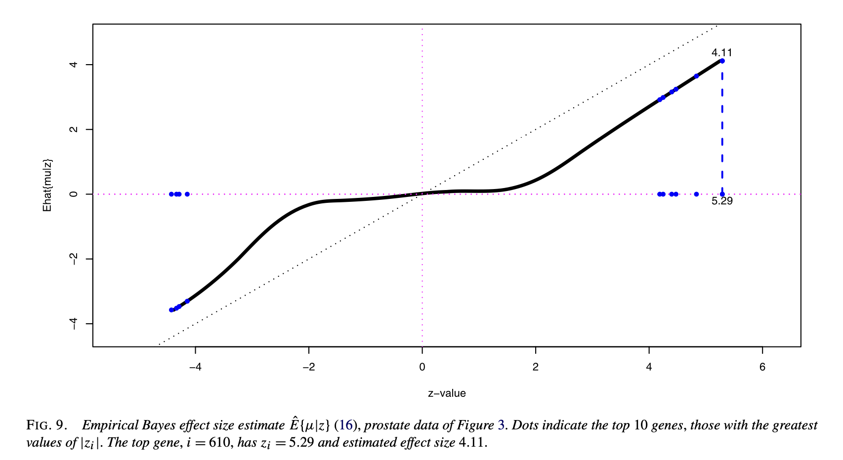
Normal hierarchical model

Slide 26
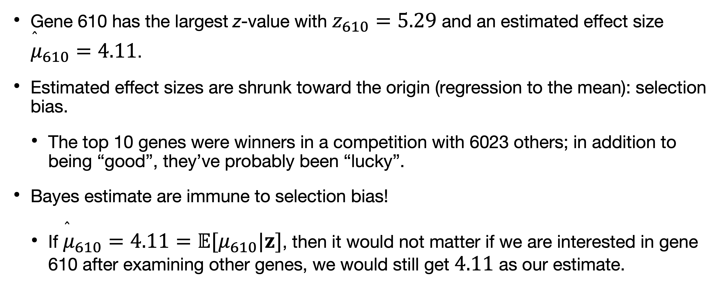
Normal hierarchical model
Gene 610 has the largest z-value with $z_{610}=5.29$ and an estimated effect size ${\overset{̂}{μ}}_{610}=4.11$.
Estimated effect sizes are shrunk toward the origin (regression to the mean): selection bias.
The top 10 genes were winners in a competition with 6023 others; in addition to being “good”, they’ve probably been “lucky”.
Bayes estimate are immune to selection bias!
If ${\overset{̂}{μ}}_{610}=4.11=𝔼[μ_{610}|z]$, then it would not matter if we are interested in gene 610 after examining other genes, we would still get $4.11$ as our estimate.

Slide 27
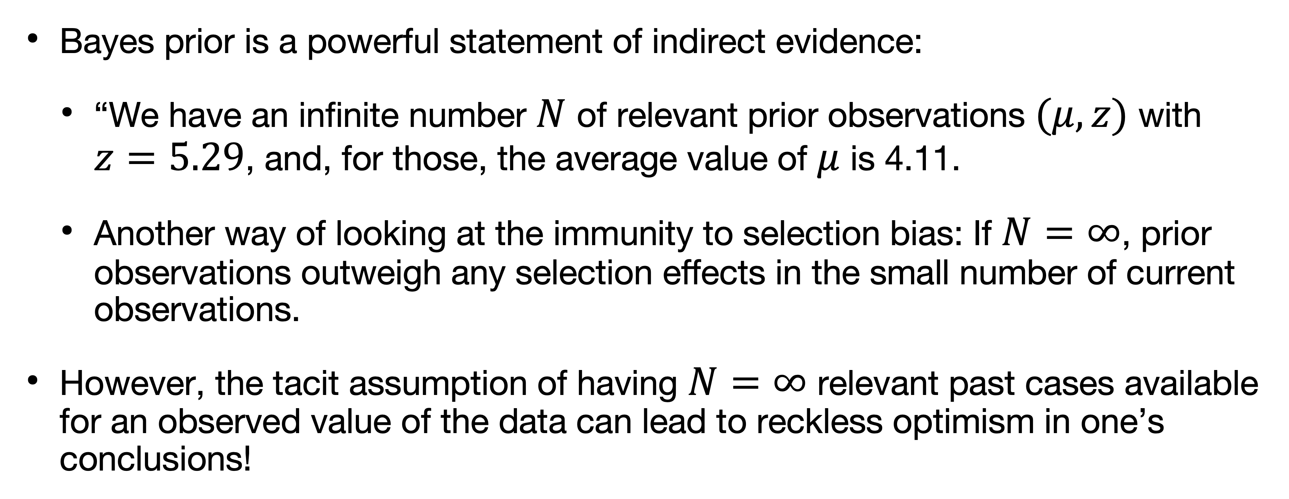
Normal hierarchical model
Bayes prior is a powerful statement of indirect evidence:
“We have an infinite number $N$ of relevant prior observations $(μ,z)$ with $z=5.29$, and, for those, the average value of $μ$ is 4.11.
Another way of looking at the immunity to selection bias: If $N=∞$, prior observations outweigh any selection effects in the small number of current observations.
However, the tacit assumption of having $N=∞$ relevant past cases available for an observed value of the data can lead to reckless optimism in one’s conclusions!

Slide 28
Frequentist-Bayes
Small-sample direct-evidence:
Fisherman procedures often provided a pleasant comprise: MLEs can be interpreted from both viewpoints as a preferred way of combining evidence from different sources.
Fisher’s theory was developed in a small-sample direct-evidence framework.
Large-scale data indirect evidence:
Empirical Bayes is the most promising for combined Bayesian-frequentist approach to Efron.
“[…] but they have been “promising” for 50-plus years now, and have yet to form into a coherent theory.”

Slide 29
Tacit assumptions lead to paradox

Slide 30
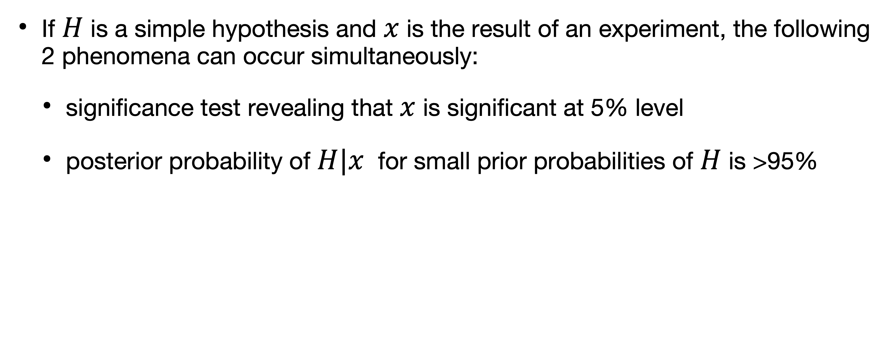
A classical paradox
If $H$ is a simple hypothesis and $x$ is the result of an experiment, the following 2 phenomena can occur simultaneously:
significance test revealing that $x$ is significant at 5% level
posterior probability of $H|x$ for small prior probabilities of $H$ is >95%

Slide 31
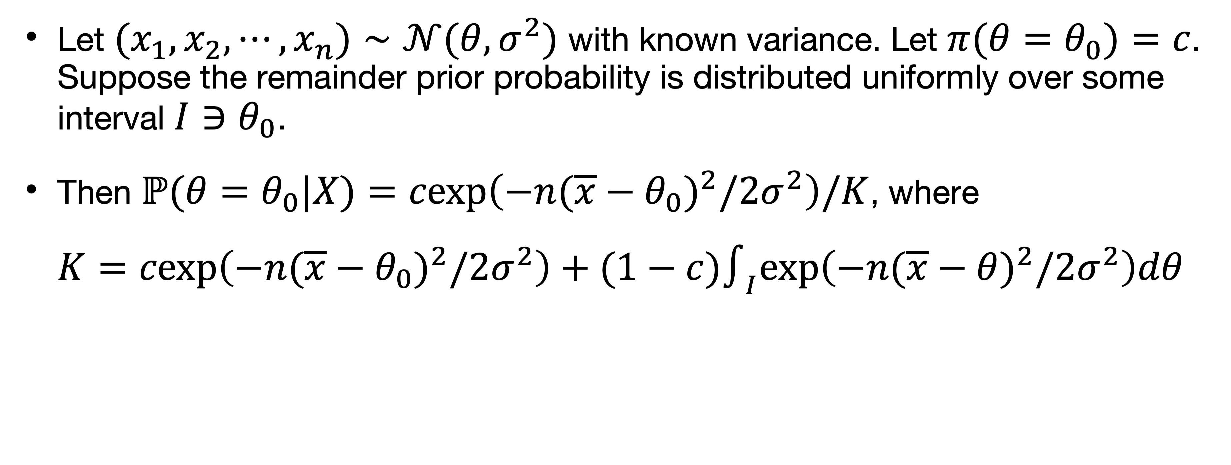
Example
Let $(x_{1},x_{2},⋯,x_{n})∼𝒩(θ,σ^{2})$ with known variance. Let $π(θ=θ_{0})=c$. Suppose the remainder prior probability is distributed uniformly over some interval $I∋θ_{0}$.
Then $ℙ(θ=θ_{0}|X)=cexp\left(−n(\overline{x}−θ_{0})^{2}/2σ^{2}\right)/K$, where
$K=cexp\left(−n(\overline{x}−θ_{0})^{2}/2σ^{2}\right)+(1−c)∫_{I}exp\left(−n(\overline{x}−θ)^{2}/2σ^{2}\right)dθ$

Slide 33
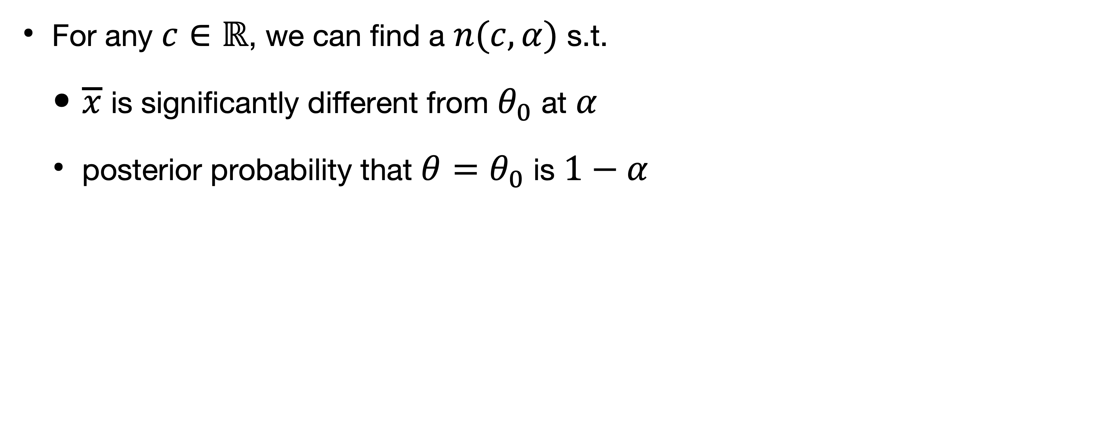
Example
For any $c∈ℝ$, we can find a $n(c,α)$ s.t.
$\overline{x}$ is significantly different from $θ_{0}$ at $α$
posterior probability that $θ=θ_{0}$ is $1−α$

Slide 34
Paradoxical results
Assumptions involved:
Bayesian: assignment of a prior distribution of the type and of the form chosen
If we can show that there exists situations where
a prior distribution of this form (point mass on the null) is reasonable
a significance test of the “tail-area” is commonly used

Slide 35
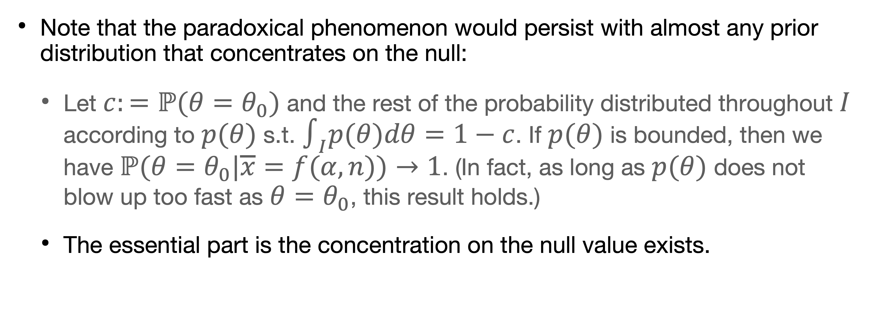
Paradoxical results
Note that the paradoxical phenomenon would persist with almost any prior distribution that concentrates on the null:
Let $c:=ℙ(θ=θ_{0})$ and the rest of the probability distributed throughout $I$ according to $p(θ)$ s.t. $∫_{I}p(θ)dθ=1−c$. If $p(θ)$ is bounded, then we have $ℙ(θ=θ_{0}|\overline{x}=f(α,n))→1$. (In fact, as long as $p(θ)$ does not blow up too fast as $θ=θ_{0}$, this result holds.)
The essential part is the concentration on the null value exists.

Slide 36
Prior probabilities
Jeffreys (1948), whose arguments have been reinforced by Ramsey (1931) and Savage (1954), argued cogently for assignment of prior distributions.
Laid down certain axioms that “a man should follow if he is to act in a ‘rational’ way”, and “defines a rational man to be a man who acts according to these axioms”.
Savage shows that a rational man must act as if he had a prior probability distribution and a utility function.

Slide 37
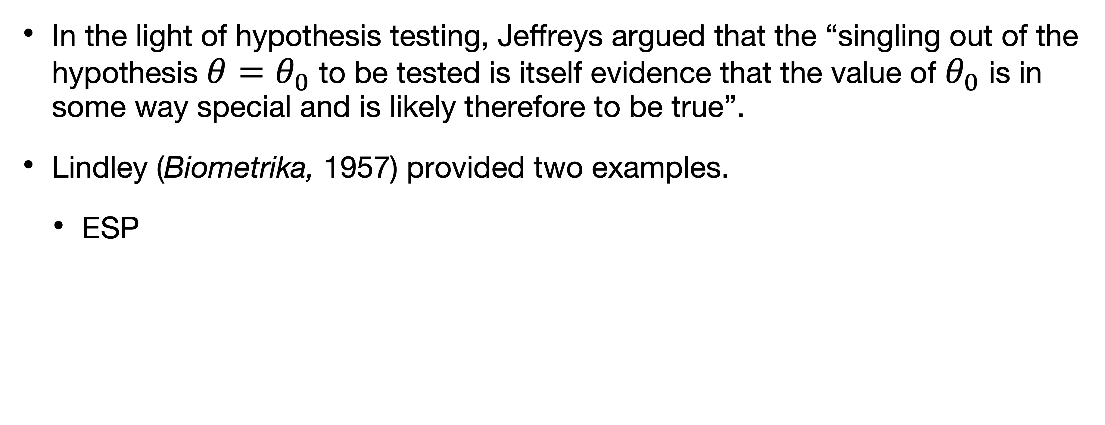
Prior probabilities that concentrate on the null
In the light of hypothesis testing, Jeffreys argued that the “singling out of the hypothesis $θ=θ_{0}$ to be tested is itself evidence that the value of $θ_{0}$ is in some way special and is likely therefore to be true”.
Lindley (Biometrika, 1957) provided two examples.
ESP

Slide 38
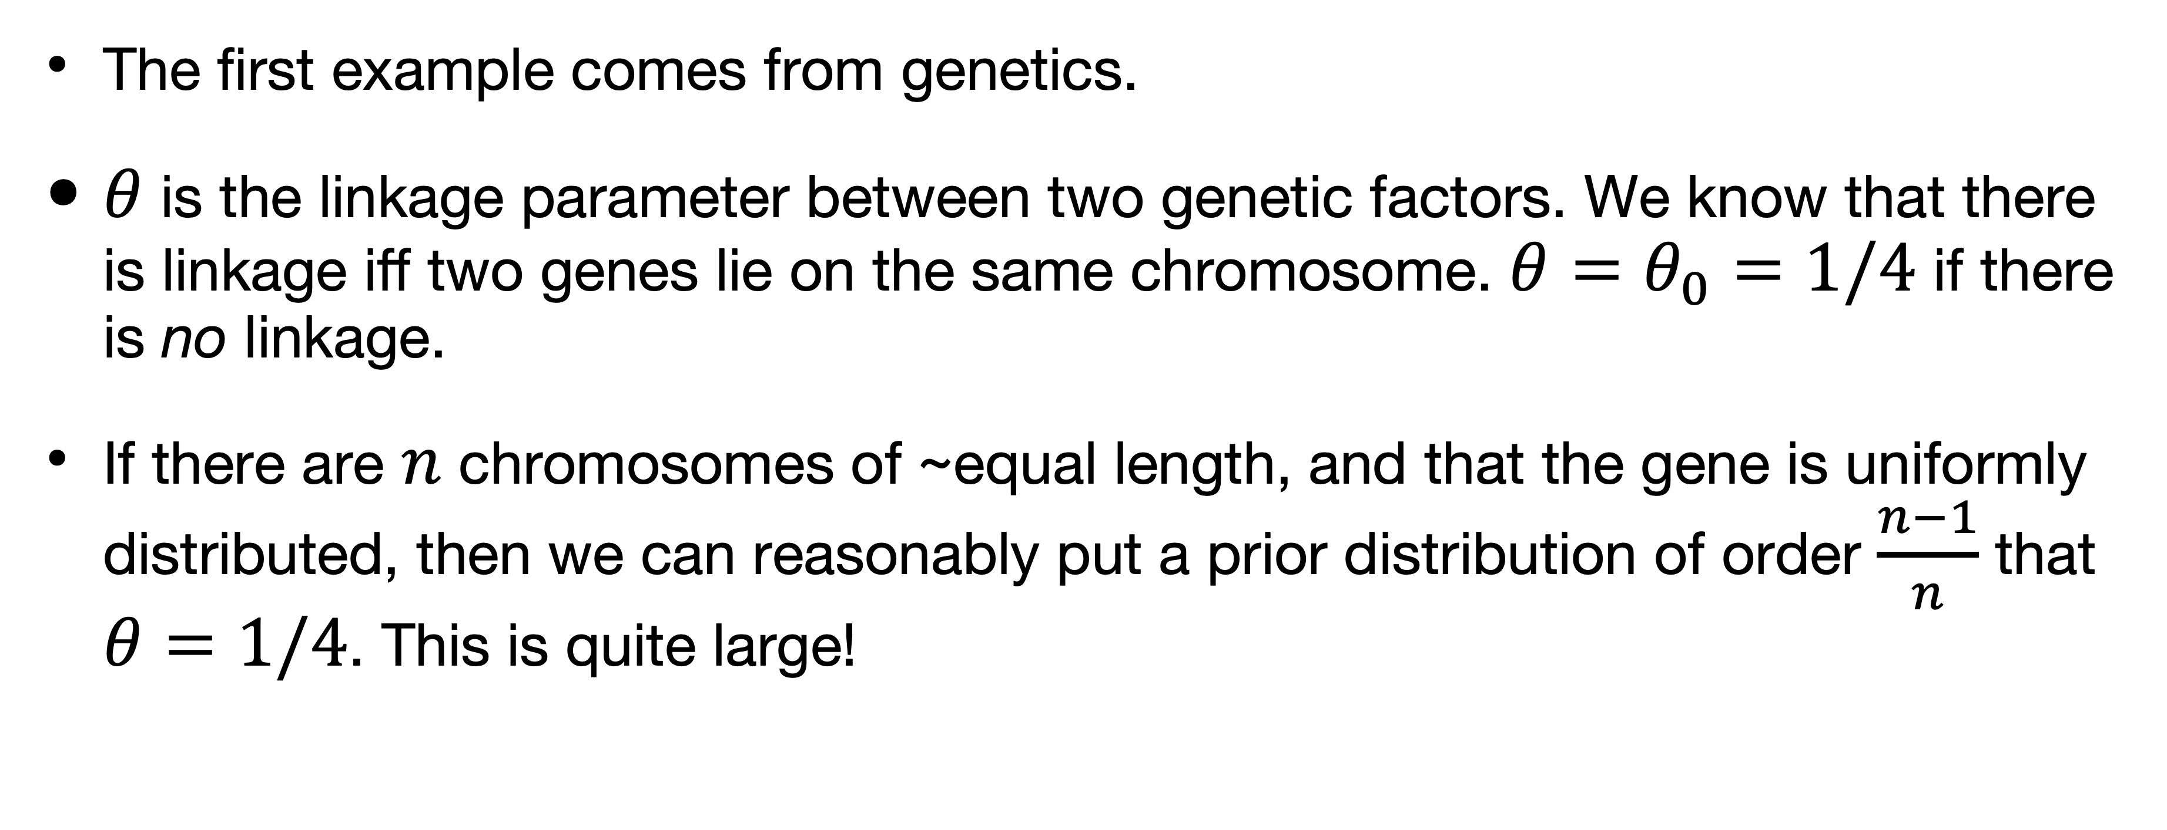
Lindley’s examples
The first example comes from genetics.
$θ$ is the linkage parameter between two genetic factors. We know that there is linkage iff two genes lie on the same chromosome. $θ=θ_{0}=1/4$ if there is no linkage.
If there are $n$ chromosomes of ~equal length, and that the gene is uniformly distributed, then we can reasonably put a prior distribution of order $\frac{n−1}{n}$ that $θ=1/4$. This is quite large!

Slide 39
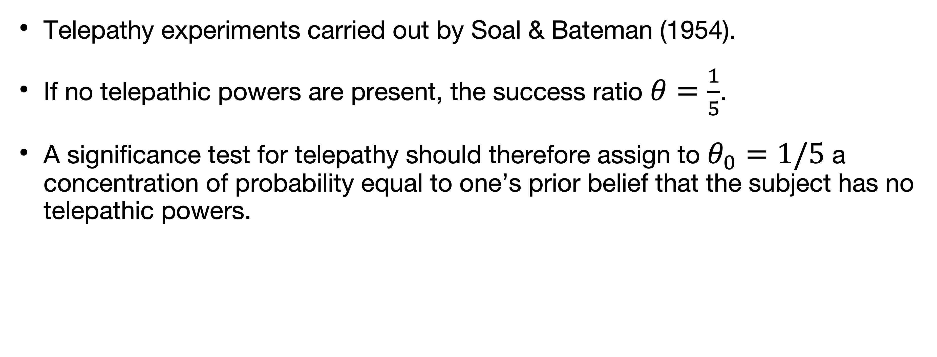
Lindley’s examples
Telepathy experiments carried out by Soal & Bateman (1954).
If no telepathic powers are present, the success ratio $θ=\frac{1}{5}$.
A significance test for telepathy should therefore assign to $θ_{0}=1/5$ a concentration of probability equal to one’s prior belief that the subject has no telepathic powers.

Slide 40
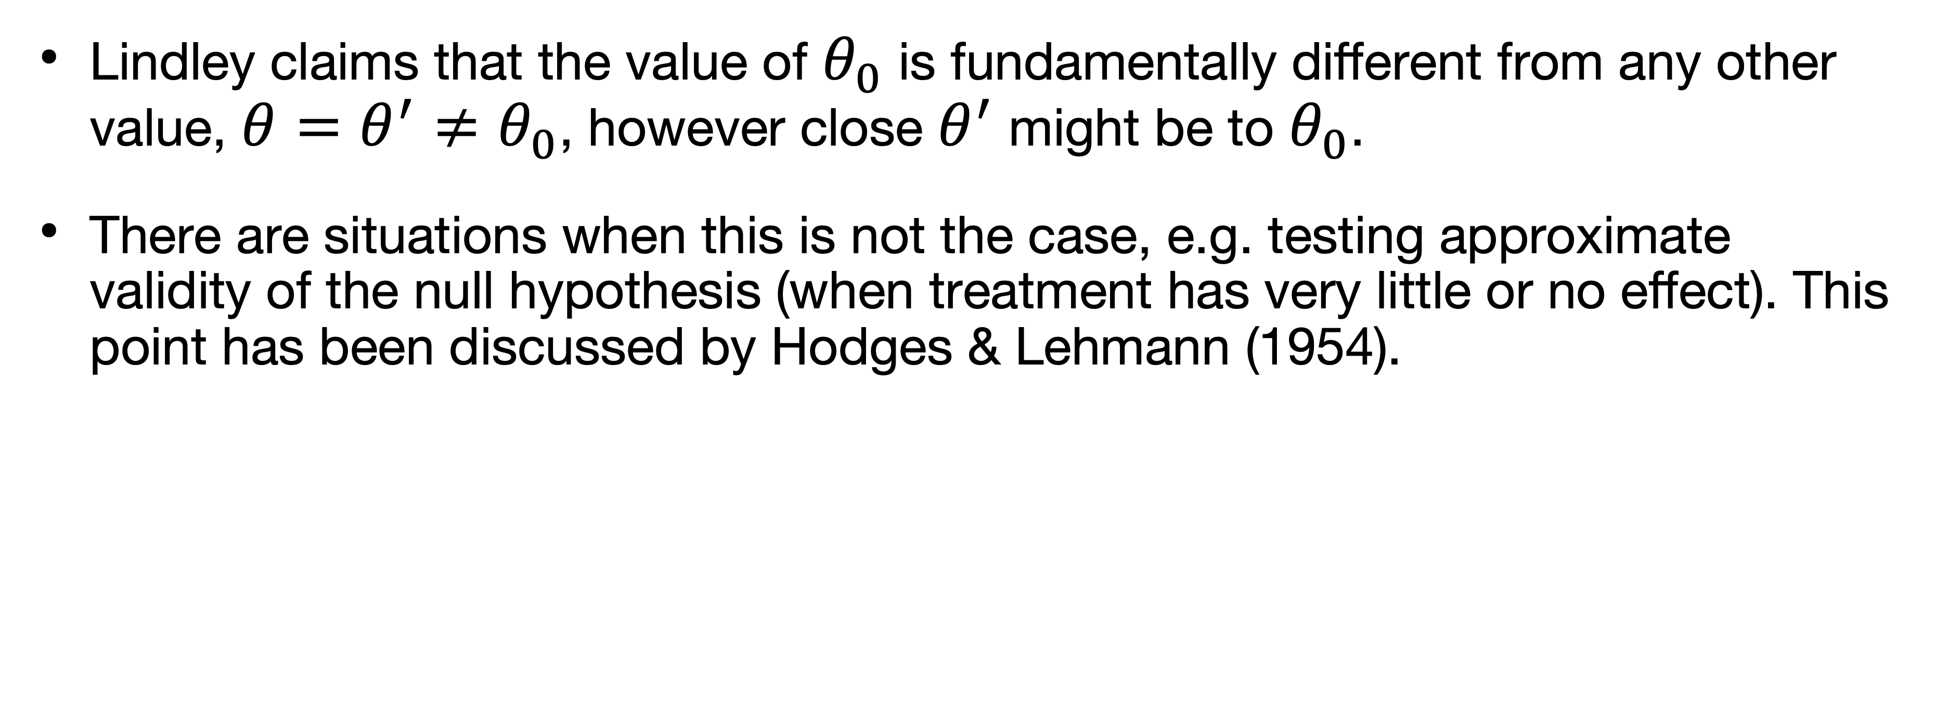
Lindley’s examples
Lindley claims that the value of $θ_{0}$ is fundamentally different from any other value, $θ=θ^{′}≠θ_{0}$, however close $θ^{′}$ might be to $θ_{0}$.
There are situations when this is not the case, e.g. testing approximate validity of the null hypothesis (when treatment has very little or no effect). This point has been discussed by Hodges & Lehmann (1954).

Slide 41
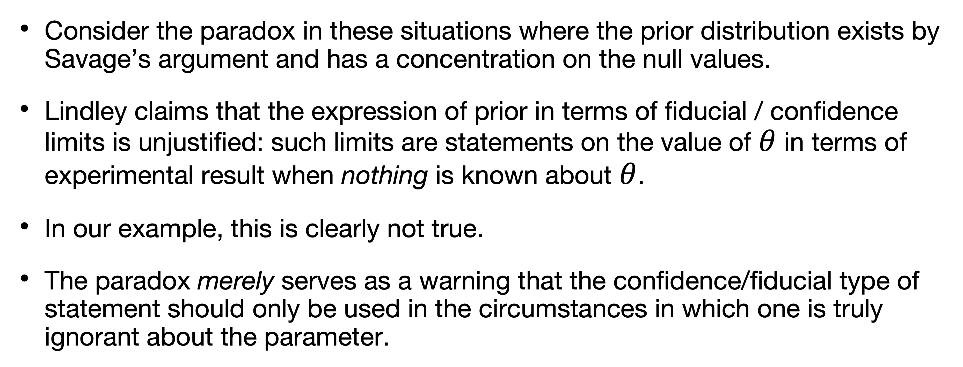
Lindley’s interpretation of paradox
Consider the paradox in these situations where the prior distribution exists by Savage’s argument and has a concentration on the null values.
Lindley claims that the expression of prior in terms of fiducial / confidence limits is unjustified: such limits are statements on the value of $θ$ in terms of experimental result when nothing is known about $θ$.
In our example, this is clearly not true.
The paradox merely serves as a warning that the confidence/fiducial type of statement should only be used in the circumstances in which one is truly ignorant about the parameter.

Slide 42
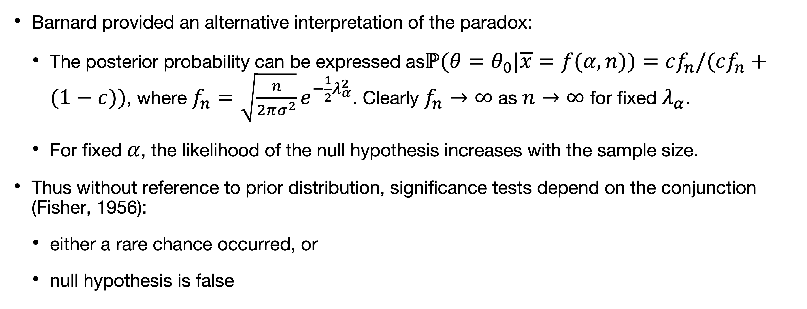
Barnard’s interpretation of paradox
Barnard provided an alternative interpretation of the paradox:
The posterior probability can be expressed as$ℙ(θ=θ_{0}|\overline{x}=f(α,n))=cf_{n}/(cf_{n}+(1−c))$, where $f_{n}=\sqrt{\frac{n}{2πσ^{2}}}e^{−\frac{1}{2}λ_{α}^{2}}$. Clearly $f_{n}→∞$ as $n→∞$ for fixed $λ_{α}$.
For fixed $α$, the likelihood of the null hypothesis increases with the sample size.
Thus without reference to prior distribution, significance tests depend on the conjunction (Fisher, 1956):
either a rare chance occurred, or
null hypothesis is false

Slide 43
Barnard’s interpretation of paradox
Without reference to prior distribution, significance tests depend on the conjunction (Fisher, 1956):
either a rare chance occurred, or
null hypothesis is false
The chance considered in a hypothesis test is the chance of the observed event (likelihood) and other more extreme ones, but these two chances behave very differently.
The paradox arises because the frequentist argument is based on area under the curve and the Bayesian argument is based on the ordinate of the curve.
The frequentist interpretation through the likelihood involves no mention of alternative hypotheses.

Slide 44
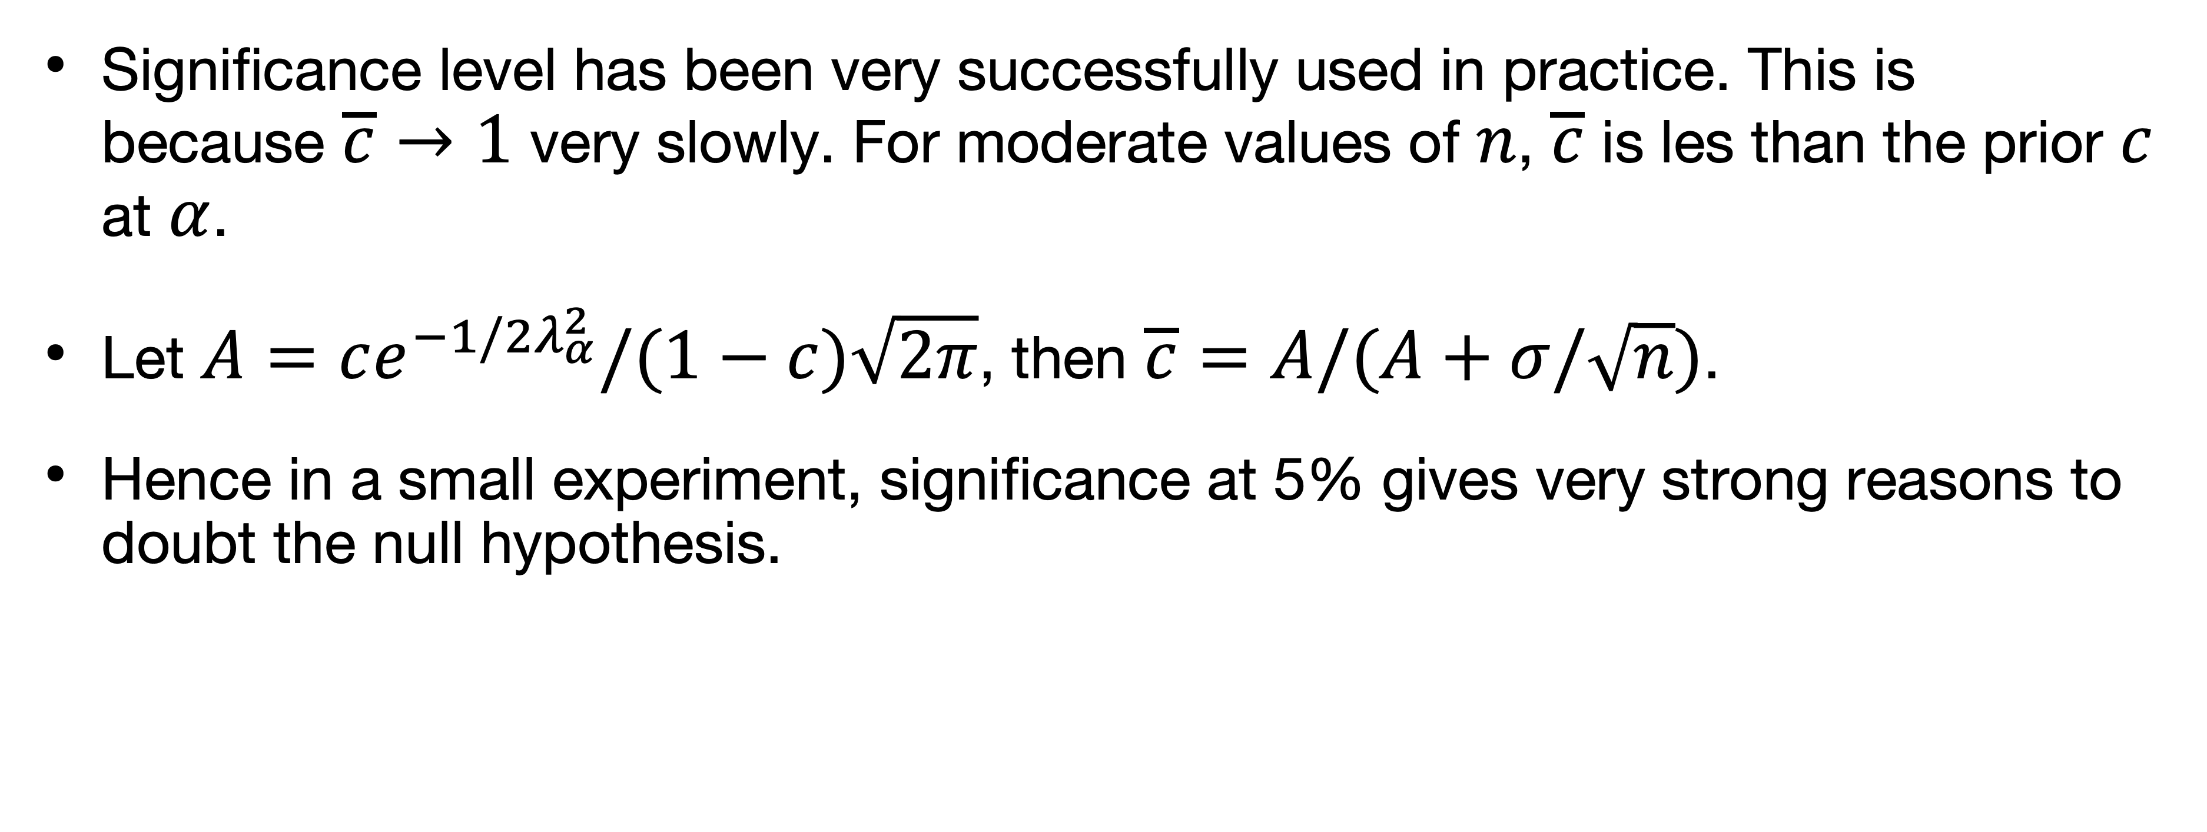
Jeffrey’s interpretation of significance
Significance level has been very successfully used in practice. This is because $\overline{c}→1$ very slowly. For moderate values of $n$, $\overline{c}$ is les than the prior $c$ at $α$.
Let $A=ce^{−1/2λ_{α}^{2}}/(1−c)\sqrt{2π}$, then $\overline{c}=A/(A+σ/\sqrt{n})$.
Hence in a small experiment, significance at 5% gives very strong reasons to doubt the null hypothesis.

Slide 45
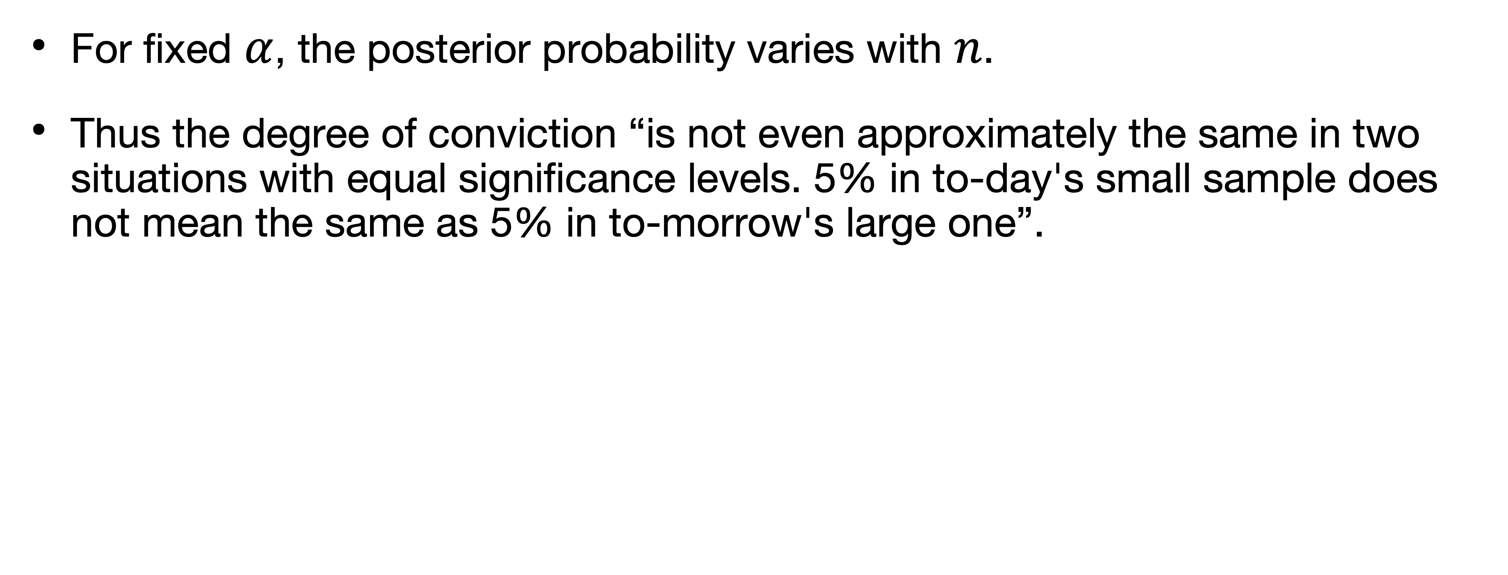
Lindley’s interpretation of paradox
For fixed $α$, the posterior probability varies with $n$.
Thus the degree of conviction “is not even approximately the same in two situations with equal significance levels. 5% in to-day's small sample does not mean the same as 5% in to-morrow's large one”.

Slide 46
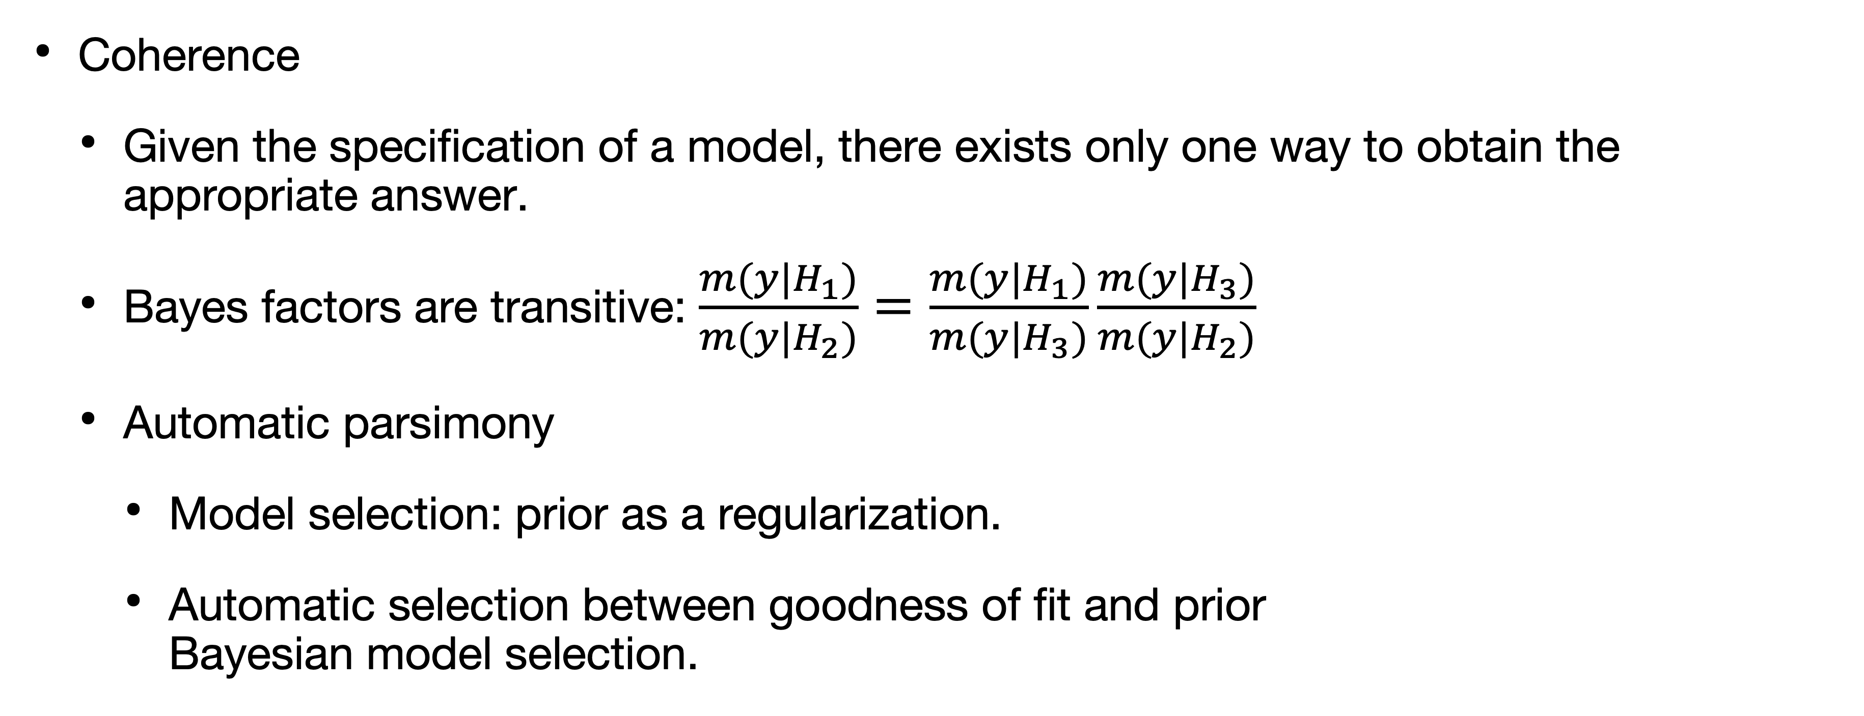
Benefits of Bayesian modeling
Coherence
Given the specification of a model, there exists only one way to obtain the appropriate answer.
Bayes factors are transitive: $\frac{m(y|H_{1})}{m(y|H_{2})}=\frac{m(y|H_{1})}{m(y|H_{3})}\frac{m(y|H_{3})}{m(y|H_{2})}$
Automatic parsimony
Model selection: prior as a regularization.
Automatic selection between goodness of fit and prior Bayesian model selection.

Slide 47
Benefits of Bayesian modeling
Flexibility
Bayesian inference allows for the flexible implementation of relatively complicated statistical techniques (such as hierarchical nonlinear models, allowing for group-level distribution).
Marginalization
Bayesian statistics makes it easy to focus on the relevant variables by inte- grating out so-called nuisance variables.

Slide 48
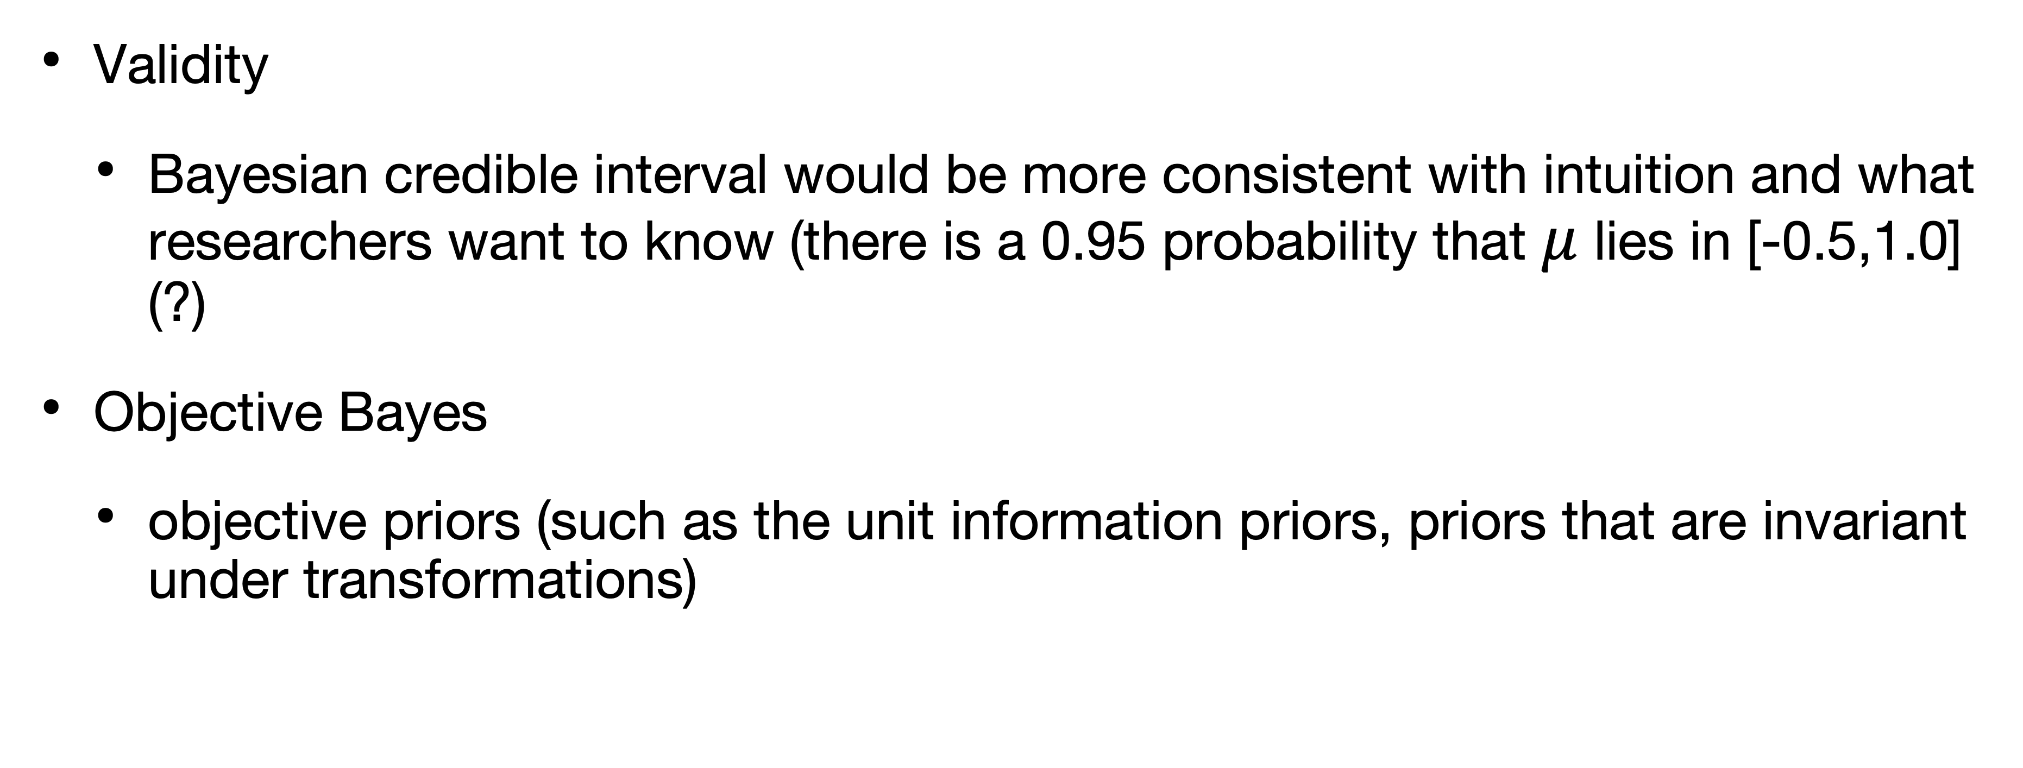
Benefits of Bayesian modeling
Validity
Bayesian credible interval would be more consistent with intuition and what researchers want to know (there is a 0.95 probability that $μ$ lies in [-0.5,1.0] (?)
Objective Bayes
objective priors (such as the unit information priors, priors that are invariant under transformations)

Slide 49
Tacit assumptions lead to paradox

Slide 50
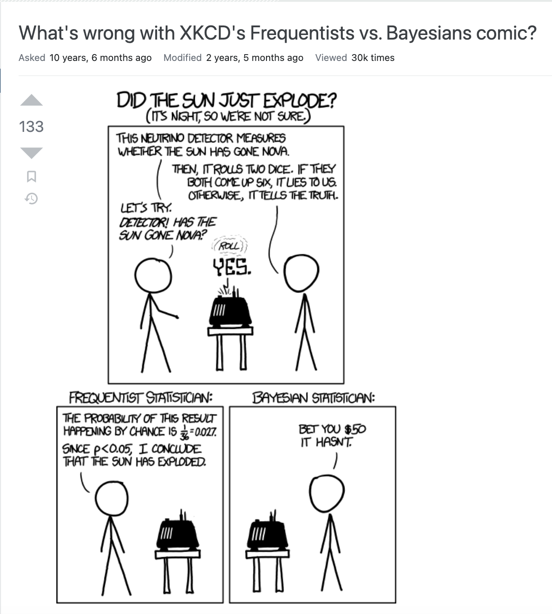
Tacit assumptions lead to paradox

Slide 51
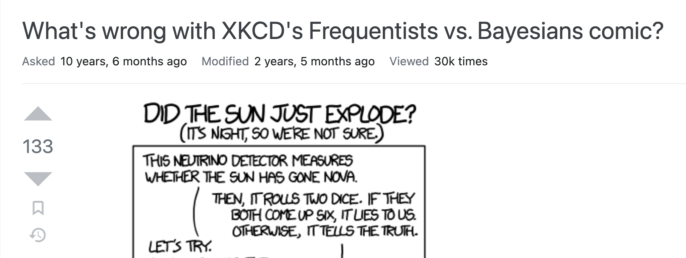
Tacit assumptions lead to paradox

Slide 52
Tacit assumptions lead to paradox
“The main issue is that the first experiment (Sun gone nova) is not repeatable, which makes it highly unsuitable for frequentist methodology that interprets probability as estimate of how frequent an event is giving that we can repeat the experiment many times.”
“In contrast, bayesian probability is interpreted as our degree of belief giving all available prior knowledge, making it suitable for common sense reasoning about one-time events. The dice throw experiment is repeatable, but I find it very unlikely that any frequentist would intentionally ignore the influence of the first experiment and be so confident in significance of the obtained results.”
https://stats.stackexchange.com/questions/43339/whats-wrong-with-xkcds-frequentists-vs-bayesians-comic/

Slide 53
References
Lindley, Dennis V. "A statistical paradox." Biometrika 44, no. 1/2 (1957): 187-192.
Wagenmakers, Eric-Jan, Michael Lee, Tom Lodewyckx, and Geoffrey J. Iverson. "Bayesian versus frequentist inference." Bayesian evaluation of informative hypotheses (2008): 181-207.
Efron, Bradley. "The Future of Indirect Evidence." Statistical Science 25, no. 2 (2010): 145-157. (Be sure to read the comments by Greenland, Gelman, and Kass.

